Slide 1

1888

Slide 2
Summary
HISTORY
What is the context ?
Where does he appear ?lieuB
CIVIL
What does the press said on about him ?
Where does he appear ? (cinema,book)B
POLICE
What is scotland yard ?
What are the hypotesis about him ?
Who are the suspects ?B
Who are the victims ?B
CONCLUSION

Slide 3


Slide 4

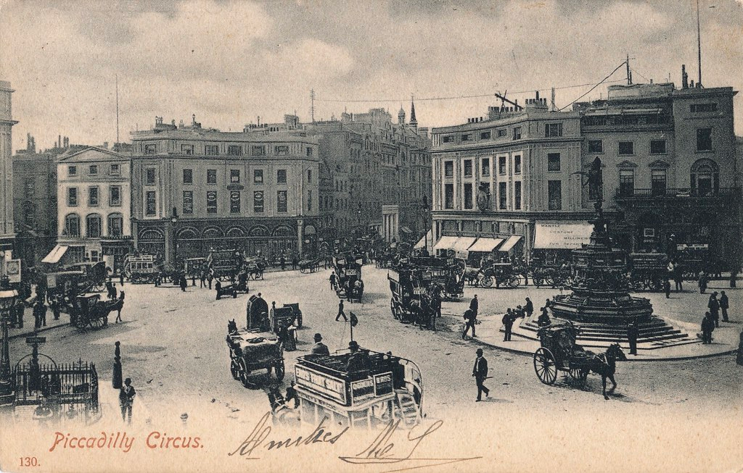
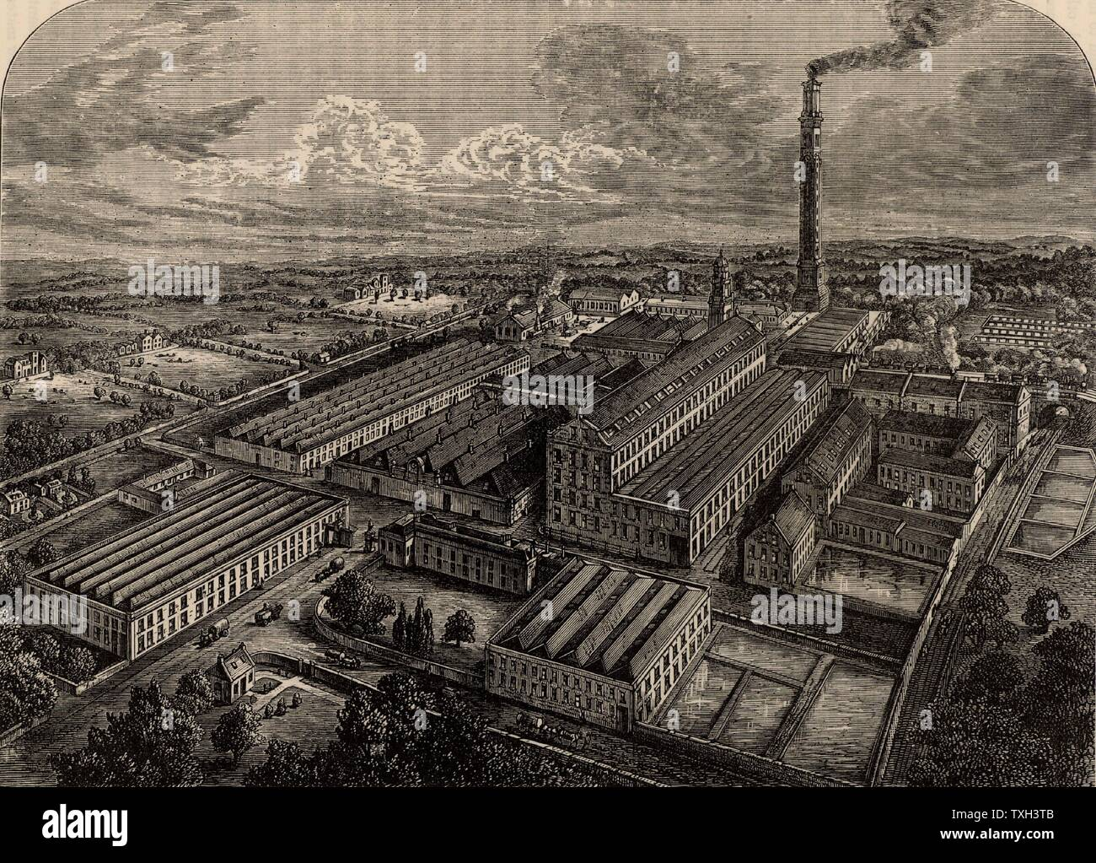
The murders took place in the 19 siecle when united kingdom was the first world power .
The queen was victoria (1837-1901). United kingdom had the biggest colonial empire
London is the most populated city and the biggest metropol
Those immigrants lived in poor district (like whitechapel) where insecurity reigned .

Slide 5
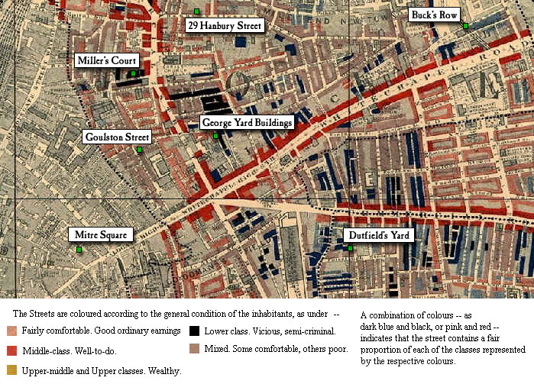

Slide 6
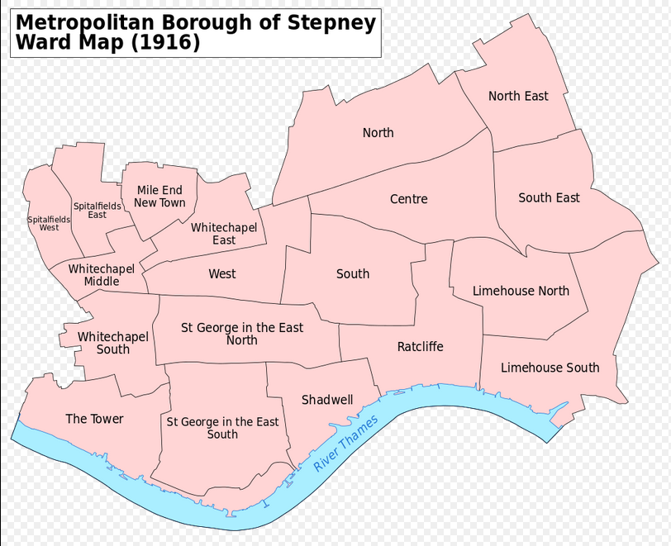

Slide 7
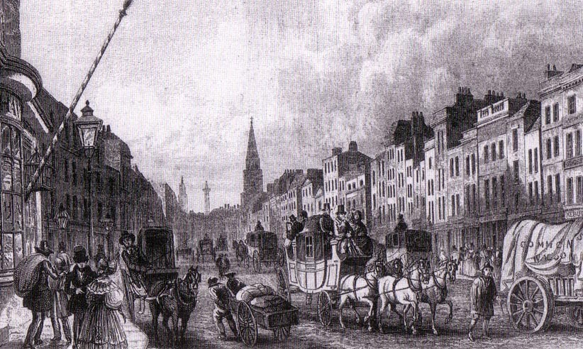
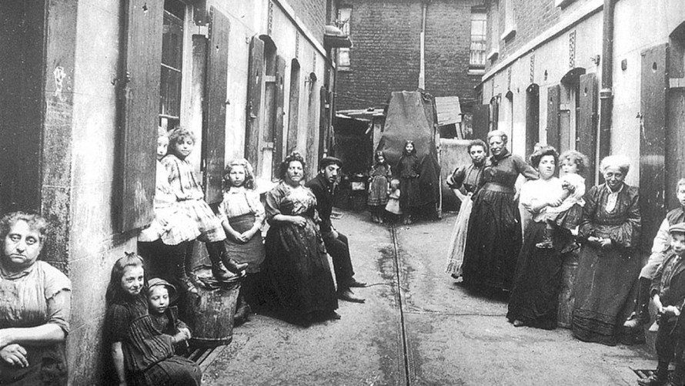
Jack the ripper, and his murders happened in london,between 1888 and 1892 (look what is the context ) in whitechapel district.
Whitechapel is a district really poor where there were a lot of pubs and drunkard(voc), there were also factory who transformed the district’s air into a black cloud(voc)

Slide 8


Slide 9


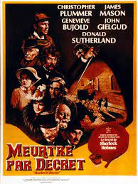
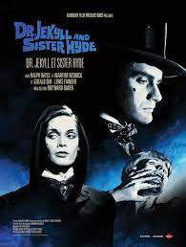
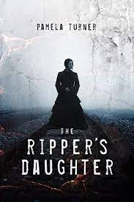
Jack the Ripper appears in many films , the favorites of an internet user are :
-«Murder by decree» (1979) produce by Bob Clark in France.
-“DrJekyll et Sister Hyde”(1971)produce by Roy Ward Baker in France.
-« Jack the ripper’s daughter »(1971)by Peter Sasdy Jack the

Slide 10
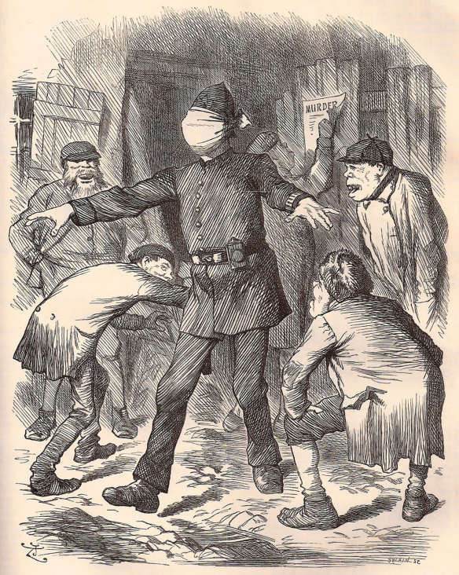
Jack will send 3 letters to the press
-160 newspapers describe his murders the quenne herself was worried
-The press and people laughed the police

Slide 11
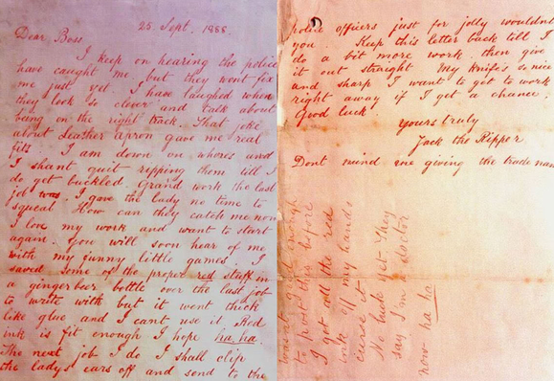

Slide 12
POLICE

Slide 13
First the police did not care about this murders because the victims were prostitutes but he was a serial killer.
Scotland Yard will questioned 2000 person
One doctor did the « psychological profile of Jack the ripper »
For the society ,Jack can’t be an English, a gentleman so it was, for sure, an immigrant (like Jewish and Irish)

Slide 14

At least 100 suspects
Prince Albert Victor of Wales heir to the crown of Great Britain,
the doctor and surgeon Sir William Gull,
the painter and artist Walter Sickert,
James Maybrick,
Sir Leslie Melville Macnaghten,
Francis J. Tumblety and The Tenant (Wentworth Bell Smith)
and Aaron Kosminski (he is the one of the most suspected).
They all have been the subject of books and adaptations.

Slide 15

-There were five victims assigned to Jack the ripper
-31 august 1888, Mary Ann Nichols
-7 June 1888 Annie Chapman
-30 September 1888 Elizabeth Stride and Catherine Eddowes
-5 November 1888 Mary Jane Kelly

Slide 16

During the 19 century when the UK was one of the biggest empire
In a poor district Whitechapel where reigns the insecurity
Jack ripper’s murders really existed but the character maybe not he killed 5 women
His murders were horrible
The queen herself was worried and asked to the police to hurry up the investigation
Scotland yard questioned more than 2000 person
More than 160 newspaper’s companies describe his murders

